Slide 1


CUSTOMER LOAN ELIGIBILITY PREDICTION AND VISUALIZATION USING MACHINE LEARNING AND DATA ANALYTICS
BATCH MEMBERS
1. Vasanthavasan G(513419104053)
2. Srinivasan S(513419104043)
3. Karthi keyan kalathi S(513419104701)
GUIDED BY –
Dr. K.SELVABHUVANESHWARI, M.E, Ph.D,
ASSISTANT PROFESSOR, HOD.

Slide 2

Loan Prediction is very much helpful for candidates and bank employees alike. While Approving loans, Banks are having a lot of troubles. The Bank workers oversee a large number of applications every day, which is difficult and increases the likelihood of mistakes. In this model, the huge data is collected from previously loan person and then by using machine learning algorithm will process the user input data with previous data to check he/she is eligible.

Slide 3

Banks are making major part of profits through loans, even if many people are looking for loans. It's challenging to choose a genuine applicant who will return the loan. Many errors may occur when selecting the real applicant when the process is done manually. Therefore, this proposed model are created by an machine learning-based loan prediction system and dashboard visualization that will choose the qualified applicants on its own. Both the applicant and the bank staff will benefit from this. There will be a significant reduction in the loan sanctioning period of time. In this research, this proposed system uses machine learning technique to predict the loan and data analytics to visualize an stunning dashboard.

Slide 4

To save a lot of employee time in a retail bank’s management.
To accomplish improved accuracy of the models used for predicting person eligibility for loan.
To design a web application for Prediction and Analysis of bank loan eligibility
To predict whether the loan approval to a specific individual is safe or not.
To visualize an Stunning Dashboard, Story and Report

Slide 5

Sl. No | Title | Author and publications | Year | Content
1 | Logistic Regression Model for Loan Prediction:A Machine Learning Approach | Richa Manglani and AnujaBokhare”, IEEE | 2021 | This paper gives the better idea of Logistic Regression Model for predicting a loan Eligibility
2 | Prediction of Modernized Loan Approval System Based on Machine Learning Approach | Vishal Singh, Vishal Singh, Rajat Awasthi, IEEE | 2021 | From this paper, We got information of the data testing and data training processes.

Slide 6
Sl. No | Title | Author and publications | Year | Content
3 | Machine Learning Models for Predicting Bank Loan Eligibility | Ugochukwu .E. Orji, Chikodili.H.Ugwuishiwu, Joseph.C.N. Nguemaleu, Peace. N. Ugwuanyi,IEEE Conference 2022 | 2022 | In this paper, They have provided evidence to validate this concept here using a presents six (6) machine learning algorithms
4 | Customer Loan Eligibility Prediction using Machine Learning Algorithms in Banking Sector | Ch. Naveen Kumar, D.keerthana, M.Kavitha, M Kalyani, IEEEConference2022 | 2022 | This paper provides the knowledge about model decision tree with adaboost technique to give more accuracy.

Slide 7

User will enter the required personal data to make a prediction of loan eligibility criteria. Once the data has been loaded, system will preprocess the data and extraction of features will be done. Once the features required for the prediction have been extracted system will compare the features with model and prediction will be given as final result in the end as person is eligible for approving a loan or not.

Slide 8

There is need for improvement in accuracy of prediction of loan eligibility
There is a chance that a loan could be assigned to an ineligible applicant due to low accuracy.
There is no graphical visualization of data that which person is approved and rejected for loan.

Slide 9

The primary goal of this study is to use machine learning models to predict whether a new application will be approved for a loan or not. With the use of data analytics and a browser interface, this proposed system attempt to create flexible graphical concepts for user interfaces in this project which is user friendly. Our objective is to develop a machine learning model to classify with the highest degree of accuracy possible.

Slide 10

This proposed systems goal is to create user-friendly interfaces and to implement an Interactive Dashboard representation using data analytics.
This proposed systems objective is to develop a machine learning model to classify with the highest degree of accuracy possible.
Work with all algorithm choose highest accuracy algorithm for prediction
Responsive web application is developed with prediction and data analytics technique.

Slide 11

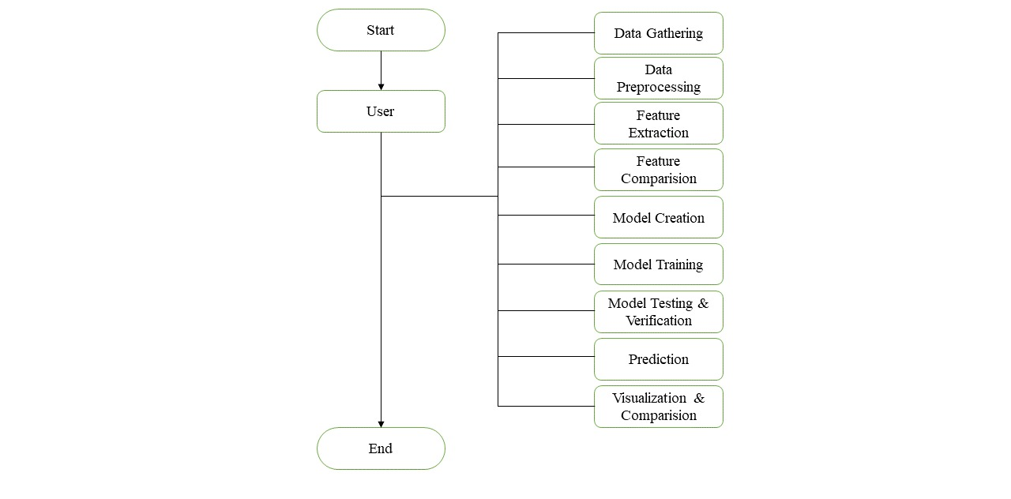

Slide 12

This Proposed System consists of three module phases:
Phase 1- Data gathering, Data preprocessing, Feature extraction
Phase 2- Feature comparison, Model creation, Model training
Phase 3- Model testing & Verification, Prediction, Visualization & Comparison
CS8611- MINI PROJECT VIVA VOCE – APRIL/MAY-2022 EXAMINATIONS

Slide 13

Hardware Requirements:
Processor (CPU) with 2 gigahertz (GHz) frequency or above
Minimum of 4 GB of RAM and minimum of 2 GB of available space on the hard disk.
Internet Connection Broadband connection with a speed of 2 Mbps or higher
NVIDIA GEFORCE GTX graphics card.
Software Requirements:
Jupiter Notebook (open source web application that you can use to create and share documents)
Programming Language – Python
Python Libraries for machine learning
IBM Cognos Analytics-Data Analytics or Power BI
Operating System - Windows 7 / Windows 8 / Windows 10
HTML, CSS, Bootstrap, JavaScript and Flask

Slide 14

According to referred research papers, Prediction accuracy is not stable for each datasets. In some situations like client going through some disaster the algorithm cannot predict the appropriate result. However This project can find out whether the client is potential to repay the loan or not, and the accuracy of this project is aim to be high compared to existing and visualize graphical representation in responsive web application

Slide 15

Richa Manglani and Anuja Bokhare, “Logistic Regression Model for Loan Prediction:A Machine Learning Approach ”, IEEE EXPLORE, 2021
Ch. Naveen kumar, D.keerthana, M.Kavitha, M.Kalyani, “Customer Loan Eligibility Prediction using Machine Learning Algorithms in Banking Sector”, IEEE EXPLORE, 2022
Ugochukwu .E. Orji, Chikodili.H.Ugwuishiwu, Joseph. C. N. Nguemaleu, Peace. N. Ugwuanyi, “Machine Learning Models for Predicting Bank Loan Eligibility”, IEEE EXPLORE, 2022
Vishal Singh, Vishal Singh, Rajat Awasthi, “Prediction of Modernized Loan Approval System Based on Machine Learning Approach”, IEEE EXPLORE, 2021
L. Udaya Bhanu1 , Dr. S. Narayana, “Customer Loan Prediction Using Supervised Learning Technique ”, International Journal of Scientific and Research Publications, 2021

Slide 16
THANK YOU

